Slide 1
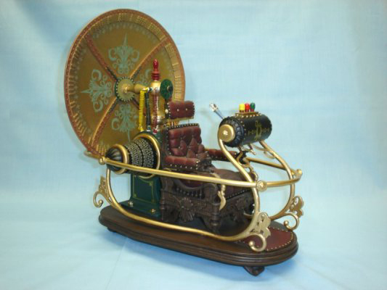
Seeing Our Past, Present, and Future
David Meyer
SP CTO and Chief Scientist

Slide 2
Agenda
The Past: Macro Trends circa 2012 (SKO)
The Present
The Future
Q&A

Slide 3
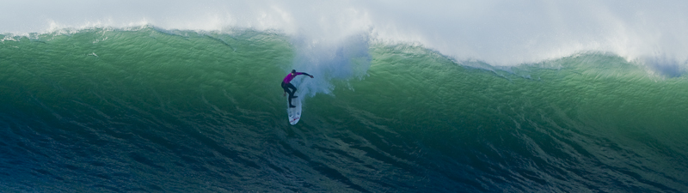
Macro trends

Slide 4
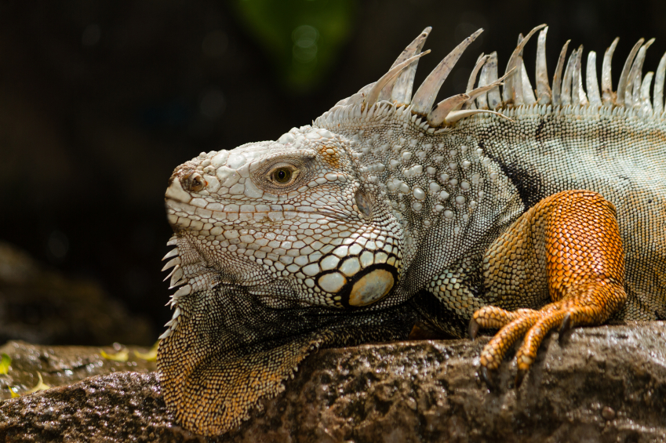
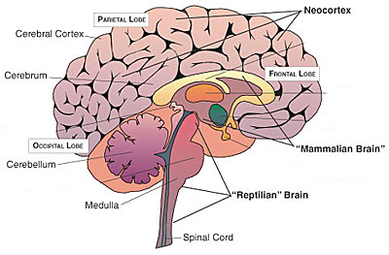
The Evolution of Intelligence
Reptilian Brain to Neocortex → Hardware to Software
HARDWARE
SOFTWARE
Notes:
The point here is that the future is in Software (Software, Software Software!)

Slide 5
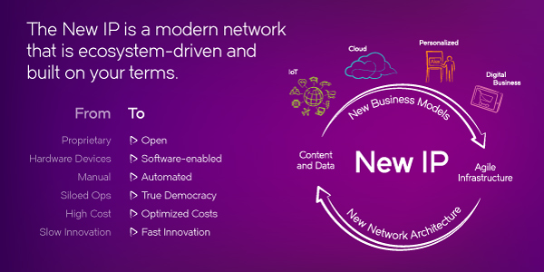
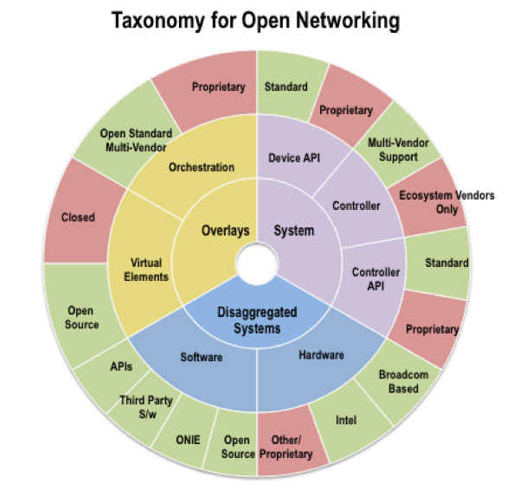
The Three Main Points I Made Back in 2012
Software
Software is how we’re going to evovle intelligence, speed and flexibility
Past: Hardware Oriented Solutions
Present: Software speed/flexibility, OpenDaylight, Open Stack, MANO, …
Open
We will make Brocade into the OPEN company
Past: Proprietary, Closed Solutions
Present: Community, OpenDaylight, Open Stack, MANO, APIs, …
Disaggregation
Decomposition/disaggregation is the way to create flexibility, add value
Past: Vertical Integration
Present: Service chains, Open Daylight, NFV, APIs, Protocols, Portable OSes, …
BTW, we have a name for this these days

Slide 6
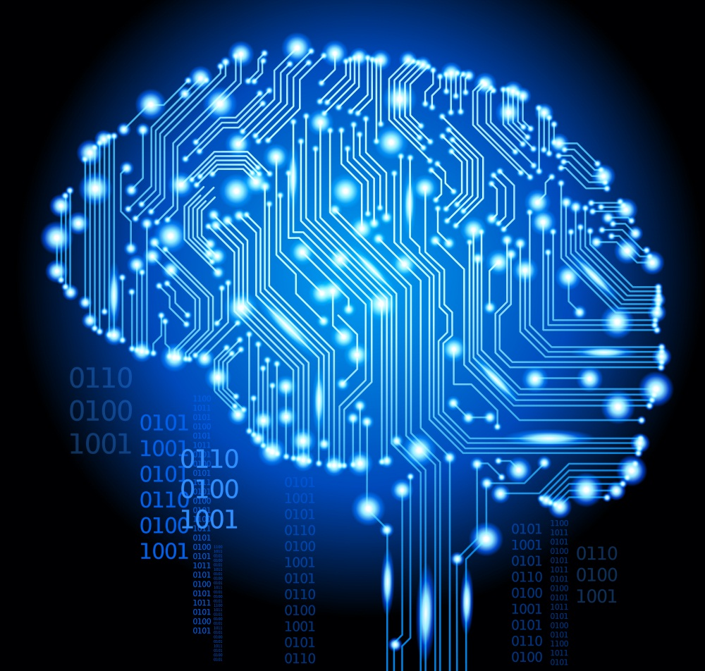
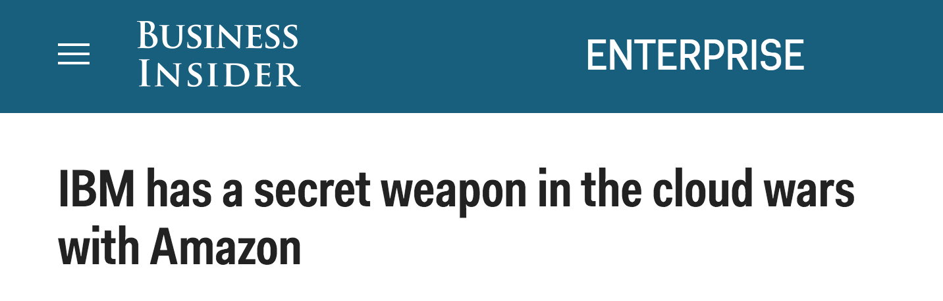
Macro Trend For Today (Seeing the Future)
The Rise of Machine Intelligence
Most of the knowledge in the world of the future will be extracted by and reside in machines
-- Yann LeCun, Director of AI Research at Facebook

Slide 7
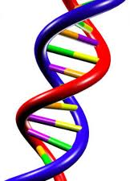
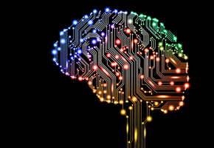
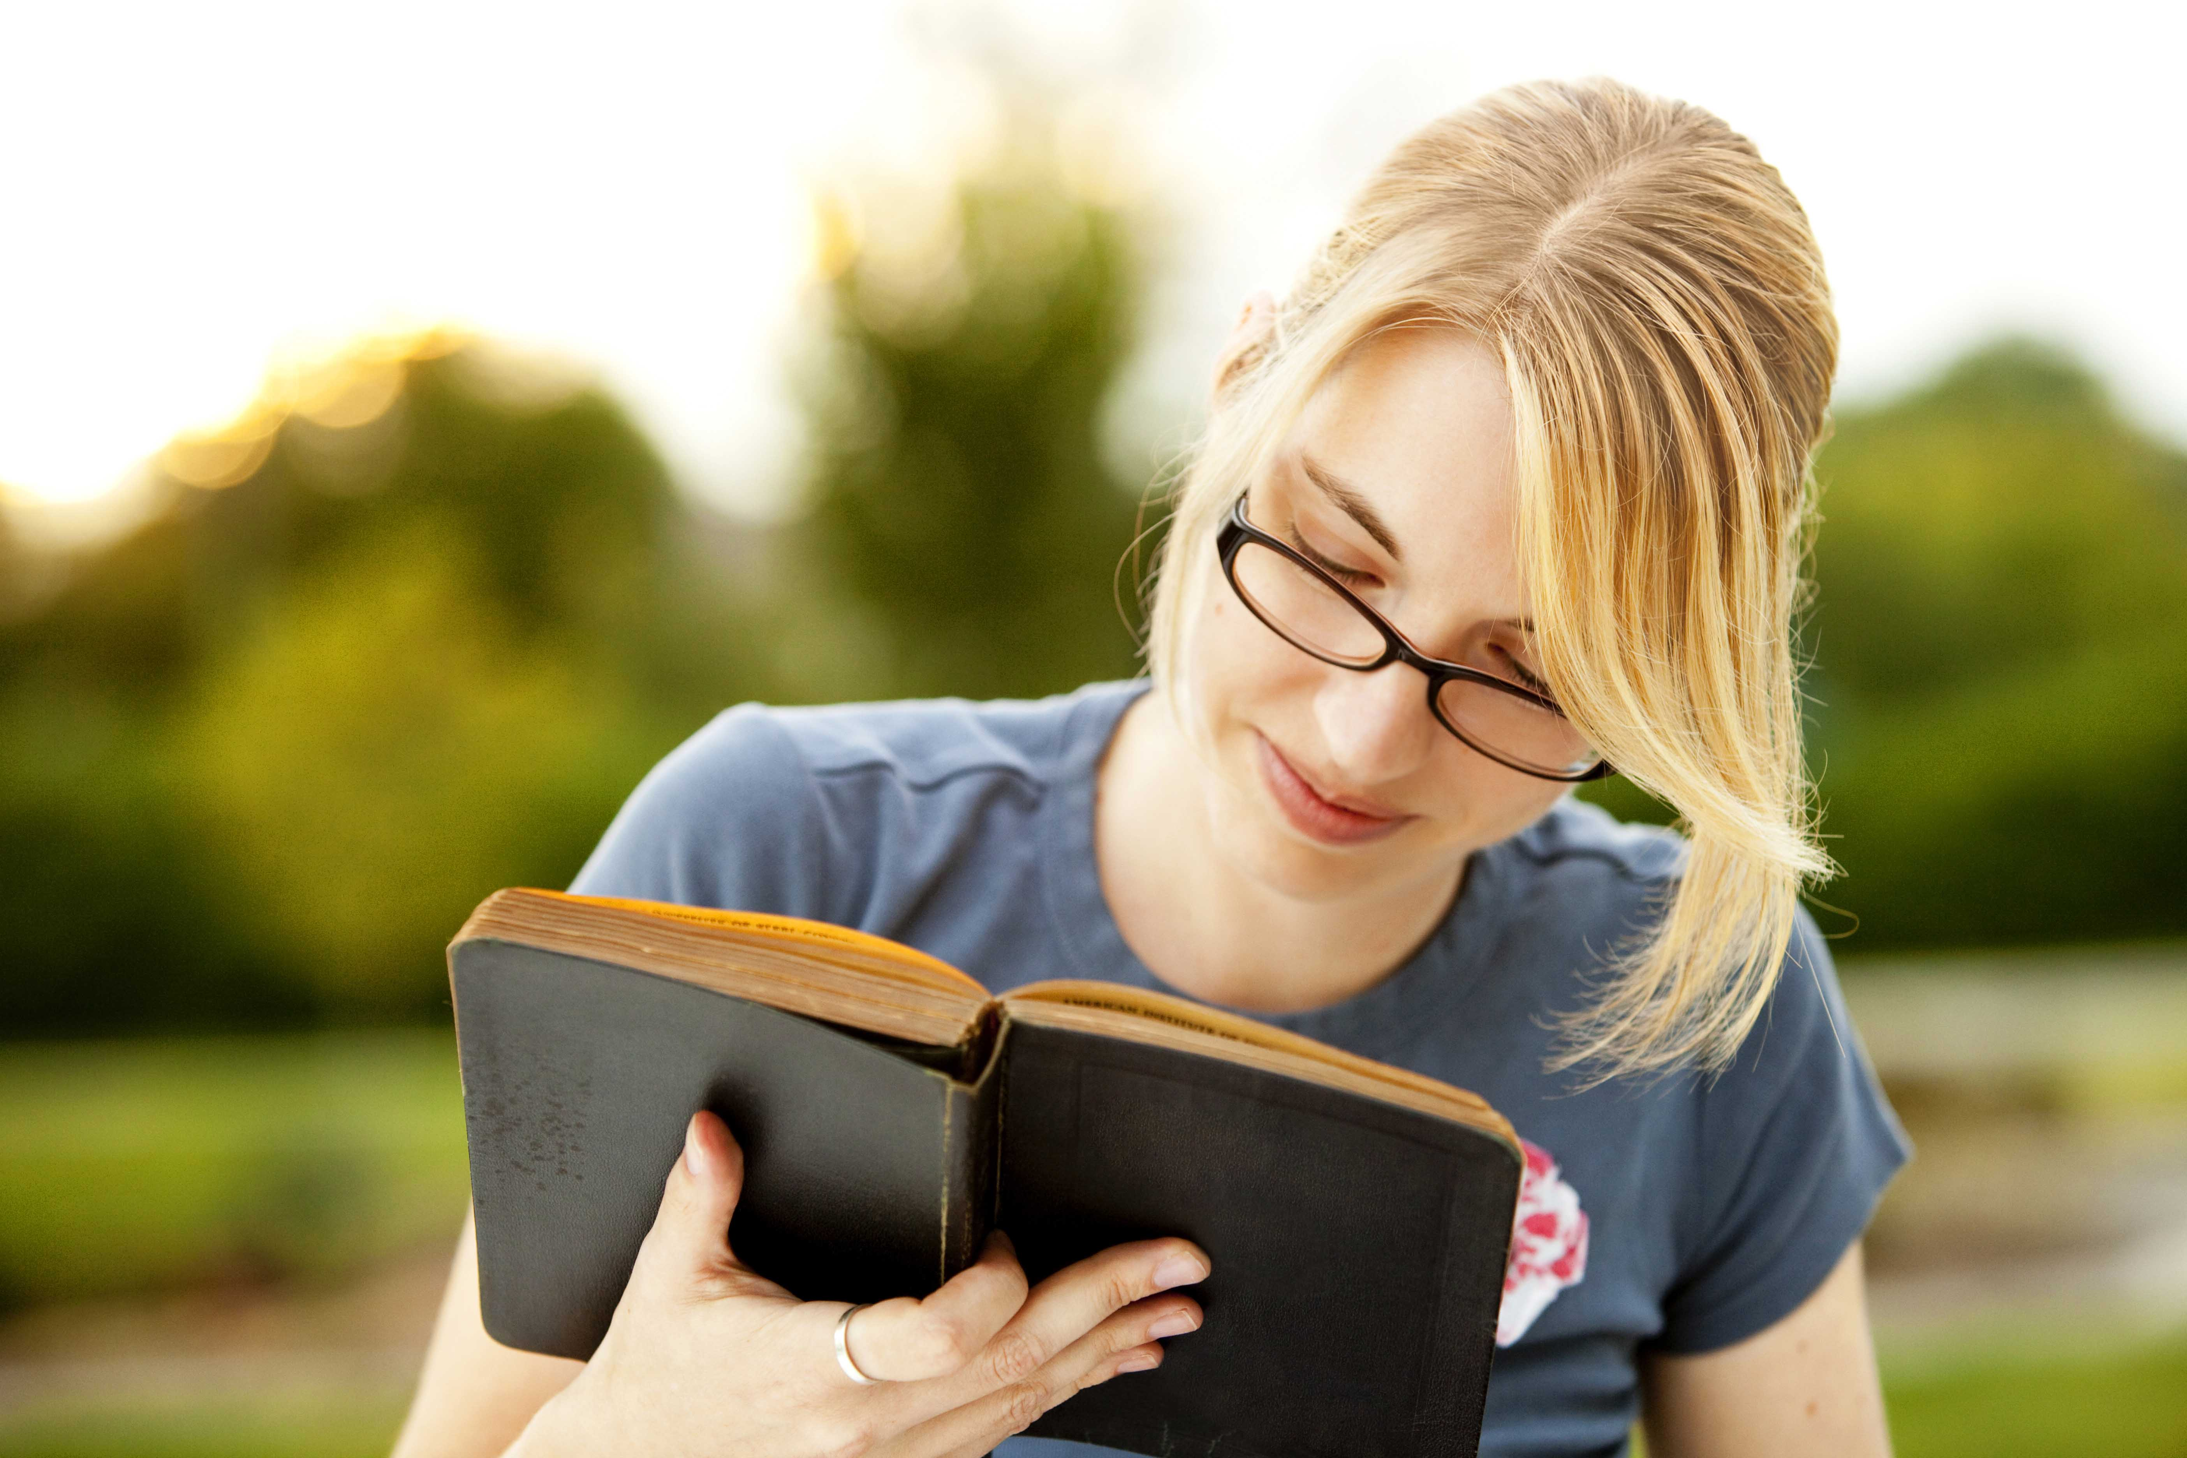
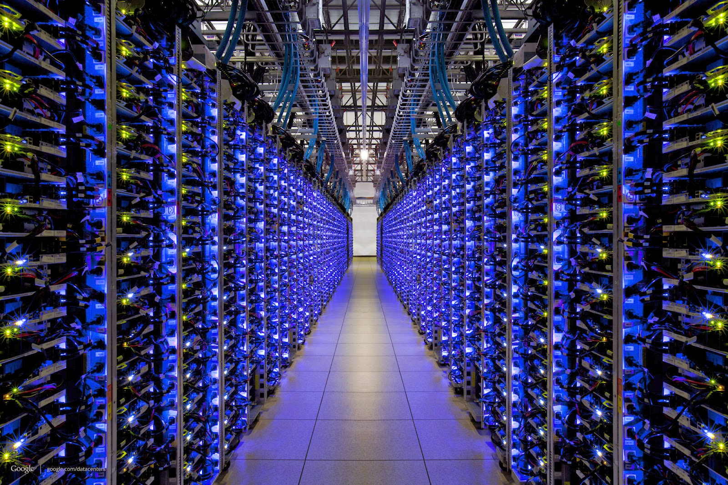
BTW, Where Does Knowledge Come From?
Evolution
Experience
Many orders of magnitude
faster and larger
Culture
Machines

Slide 8
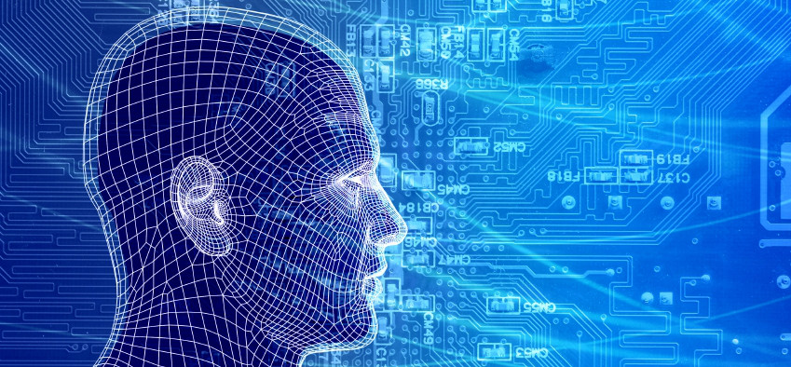
So How Can Machines Discover New Knowledge?
Fill the gaps in existing knowledge
Symbolists
Technology: Induction/Inverse Deduction
Emulate the brain
Connectionists
Technology: Deep neural nets
Emulate evolution
Evolutionaries
Technology: Genetic Algorithms
Systematically reduce uncertainty
Bayesians
Technology: Bayesian Inference
- Notice similarities between old and new
Analogizers
Technology: Kernel machines/Support Vector Machines
These correspond to the 5 major schools of thought in machine learning

Slide 9
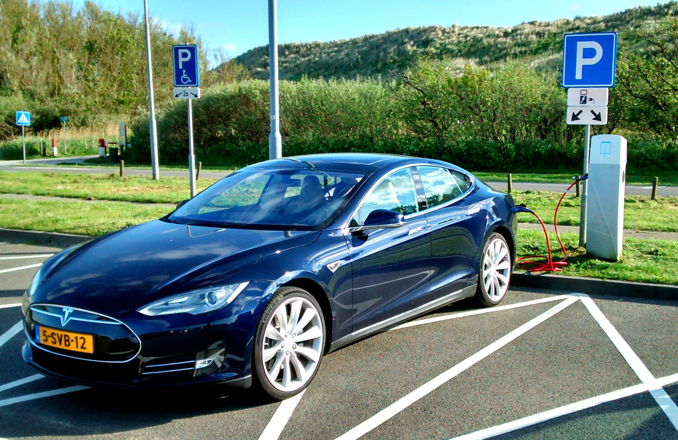
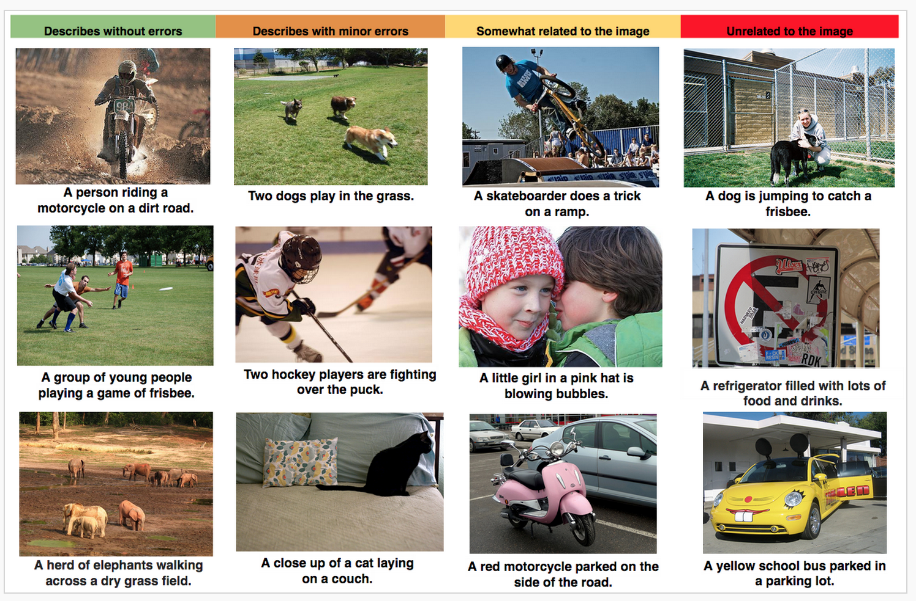

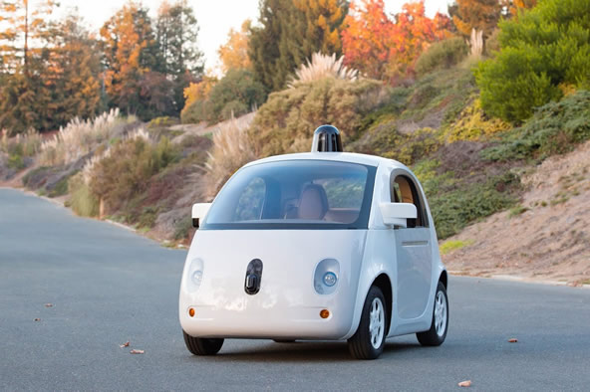
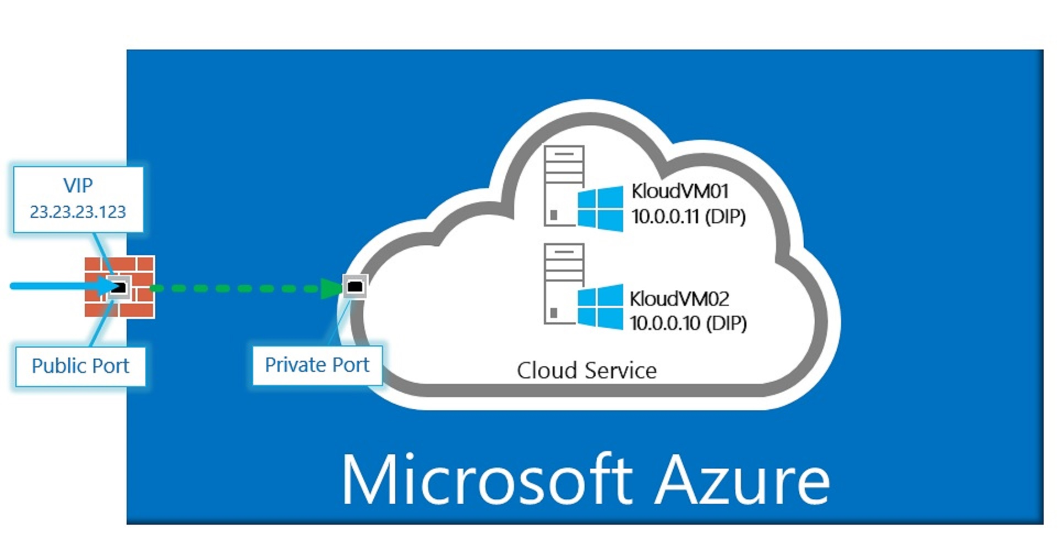
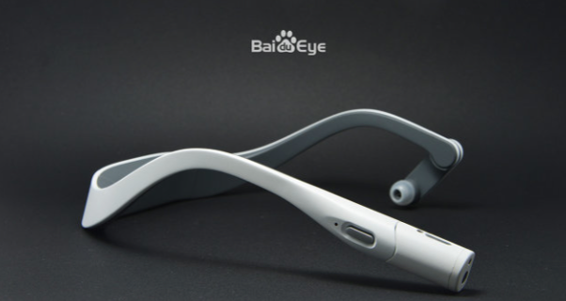
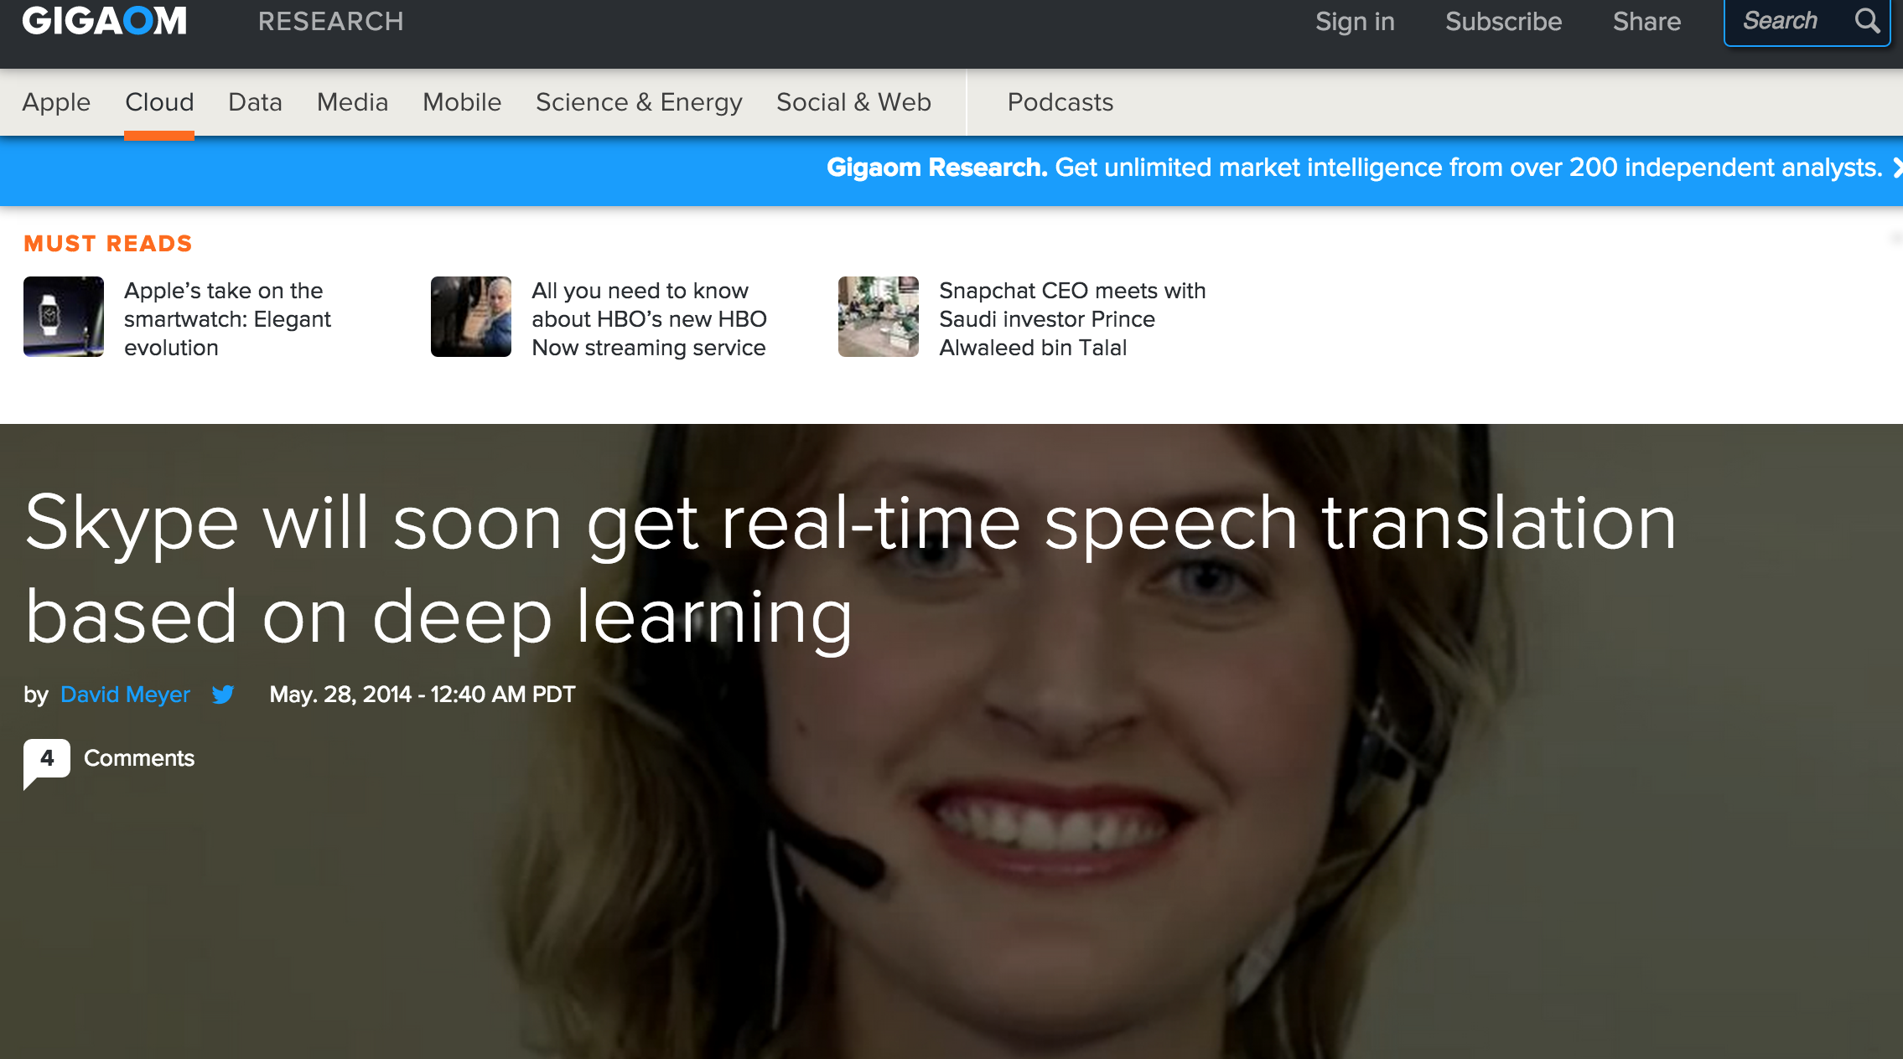
ML Applications You Interact with Everyday

Slide 10
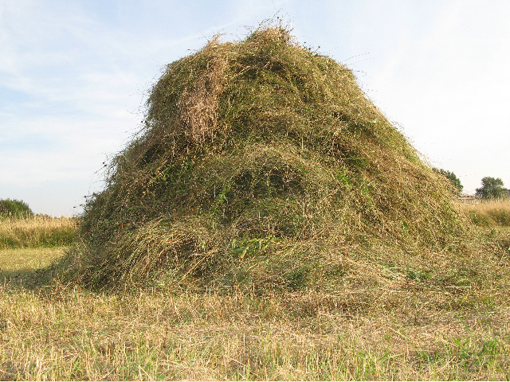
So What Are We Doing Here At Brocade?
Small Machine Learning team in the CTO’s Office
CyberSecurity/Anomaly Detection
Example: What is a good flow, what is a malicious flow
Lots of opportunity in Cybersecurity and beyond
Federal Customers
Intel partnership (DXL)
Classification problem
“Intelligence Engine” for SDN and NFV applications
Massive amount of network telemetry. Requires machine learning to understand data.
NFV Predictor
Controller path optimization (and other) applications
Brocade vEPC Exploration
Many different tools for the DevOPs community
Pioneering Machine Learning for Networking

Slide 11
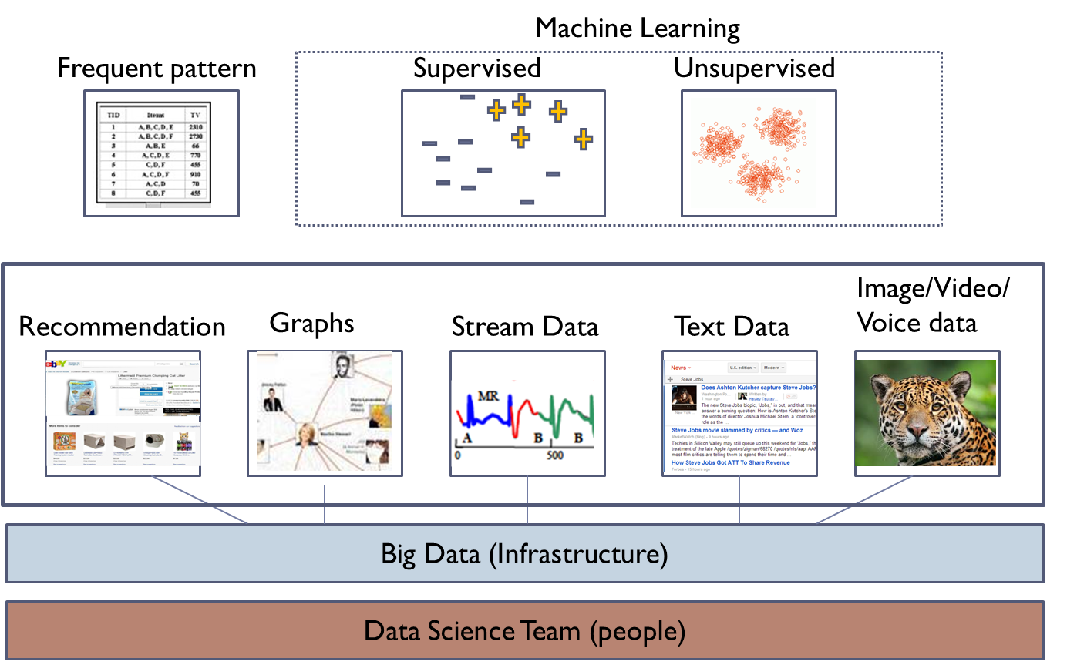
How We View the Network Intelligence Stack

Slide 12
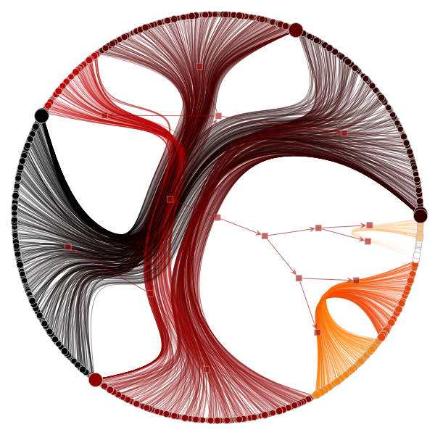
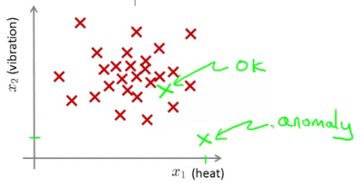
Example: Preprocessing Network Data
This work occurs at the “Big Data” level of the stack
before Machine Learning is applied
Gives us an easier path to “linear seperability”
Linear Decision Boundary
Generalization Graph Radial Nested Block State Model with Edge Bundling

Slide 13
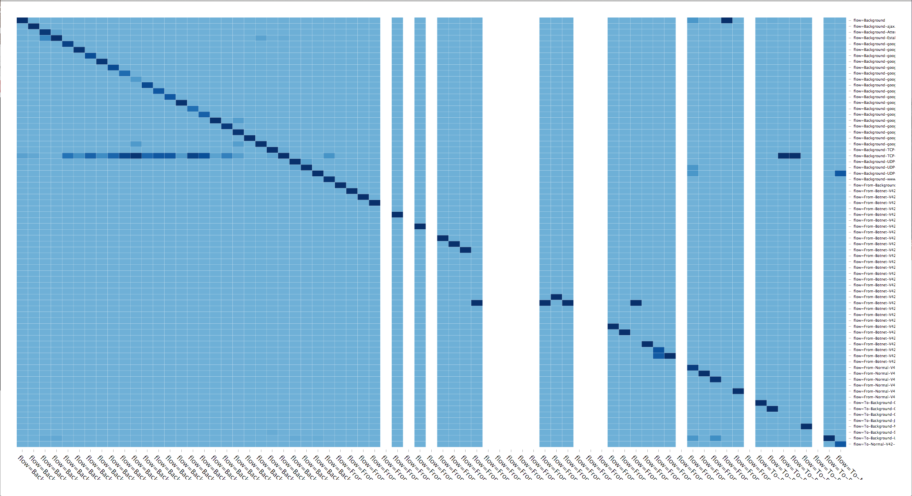
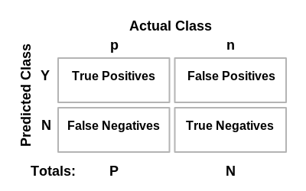
Example: Visualizing Anomaly Detection Efficiency Confusion Matrix
Briefly: What is a confusion matrix?

Slide 14

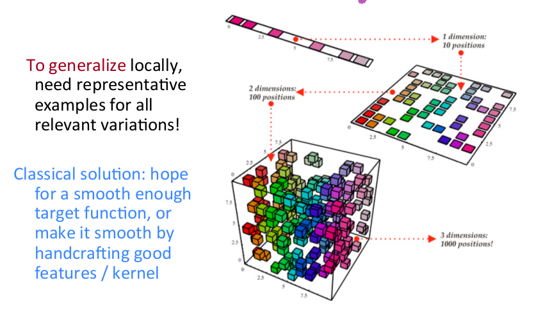
Why not just use an IDS for Anomaly Detection?
IDSes typically use fingerprints, rules and in some cases reputations
All require that you describe the anomaly
This is mathematically equivalent to tiling the input space
For example, suppose you are looking at 100 variables
Then you would have to somehow enumerate 2¹⁰⁰ different classes
Further, suppose you have a billion examples to learn from
Then you miss 2¹⁰⁰ – 10⁹ potential classes, a huge number
Machine learning can in principle generalize to these unseen cases
Whereas an IDS based on fingerprinting or rules can not
But there’s a hitch…

Slide 15
Where We’re Headed
Continue developing novel techniques for network Machine Learning
Continue to develop Cybersecurity capabilites
Productization strategies/business models in the works
Controller applications such as path optimization
Outreach to the product groups
vEPC a good example
Outreach to field
Use cases
Business models
Other help
Join our bi-weekly ML Study Group if you are interested
Continue pushing Brocade as the thought leader in this space

Slide 16

FINALLY…
IT’S NOT ONLY ABOUT GREAT PRODUCTS
THOUGHT LEADERSHIP
LEARNING AND COLLABORATION
CUSTOMER INTIMACY
GROWING THE BUSINESS
COOL FACTOR

Slide 17
Q & A
Thanks!

